Slide 1
Android app to Control Arduino LED

Slide 2
Introduction
Arduino can be connected to smartphone for customized applications
MIT App inventor is used for Arduino to android communications bi-directional
MIT App inventor is very user friendly
It does not need programming requirements
Very easy to communicate between devices

Slide 3
Today’s Model
Very basic android application
Control an LED light from android device
We will be developing android application using MIT App inventor
Circuit will be able to communicate with android using Bluetooth sensor
After connecting we will be having an ICP based on android

Slide 4
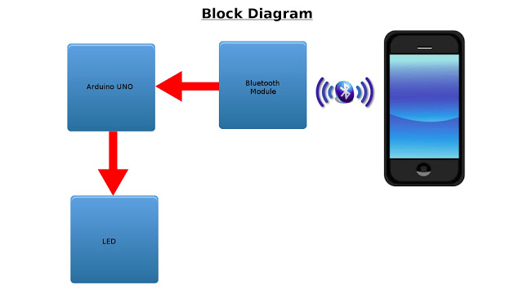
Model

Slide 5
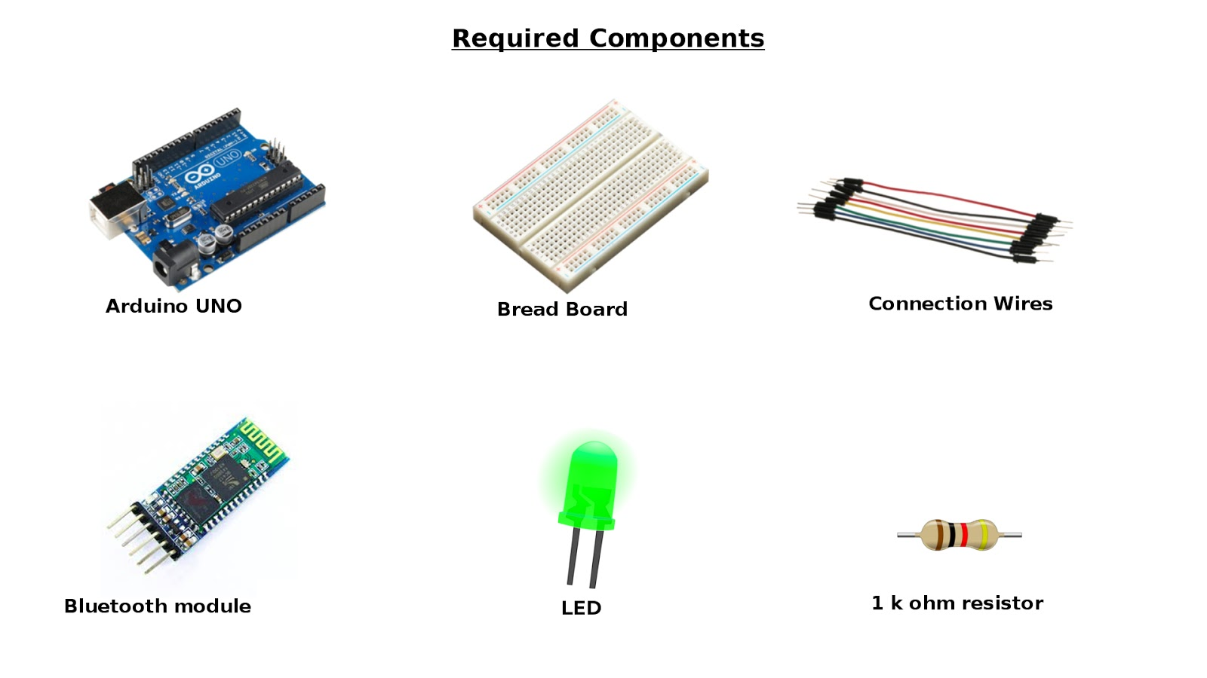
Components Required

Slide 6
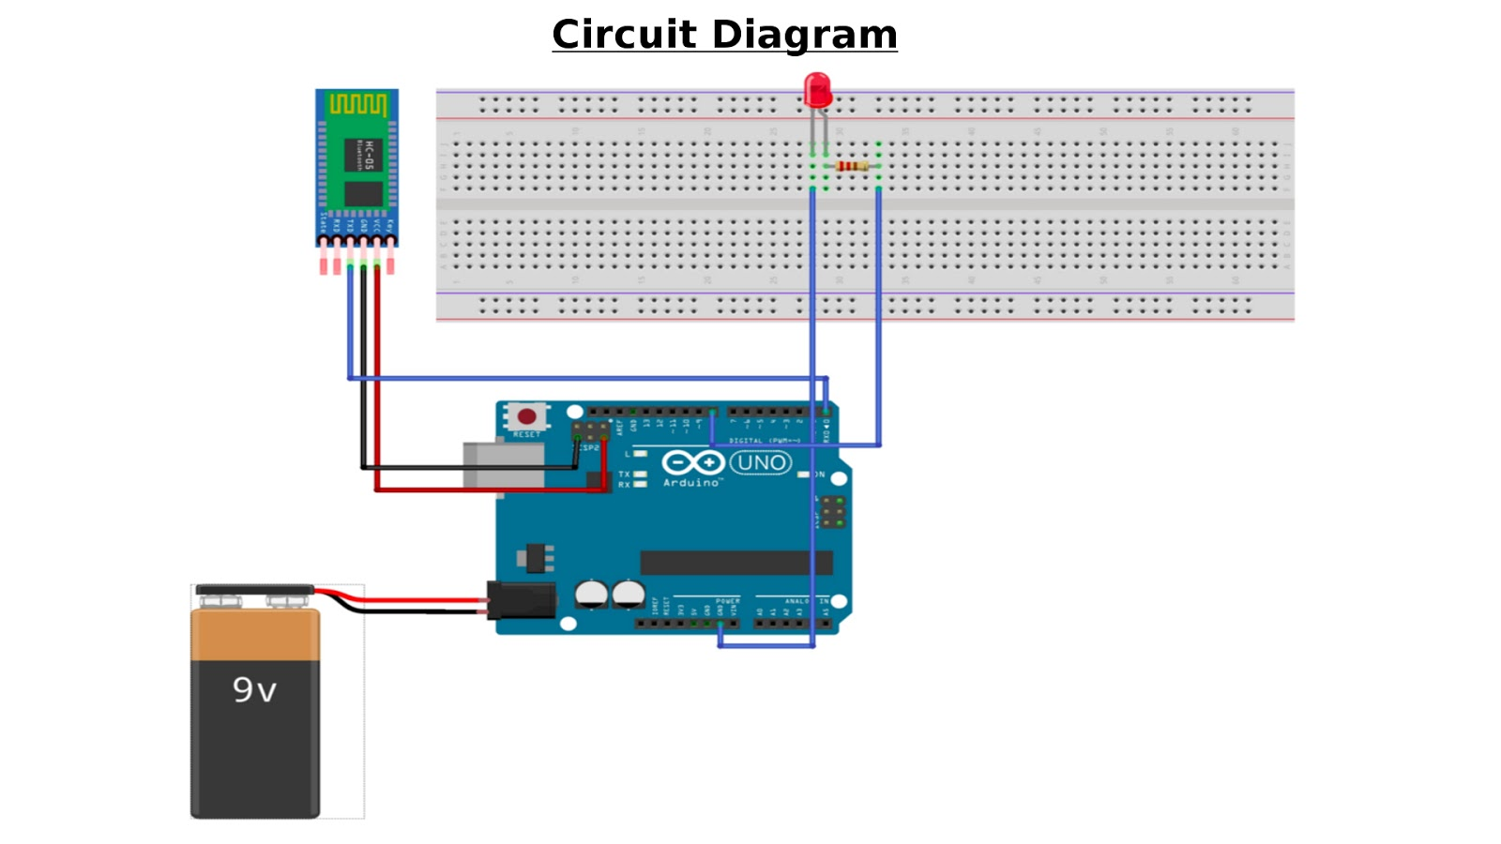
Circuit

Slide 7
Android App Development
We will be connecting android with Bluetooth
Using Bluetooth Arduino and android will communicate
There will be two basic features in android
Turn on the LED and turn off the LED
We will be doing it step wise

Slide 8
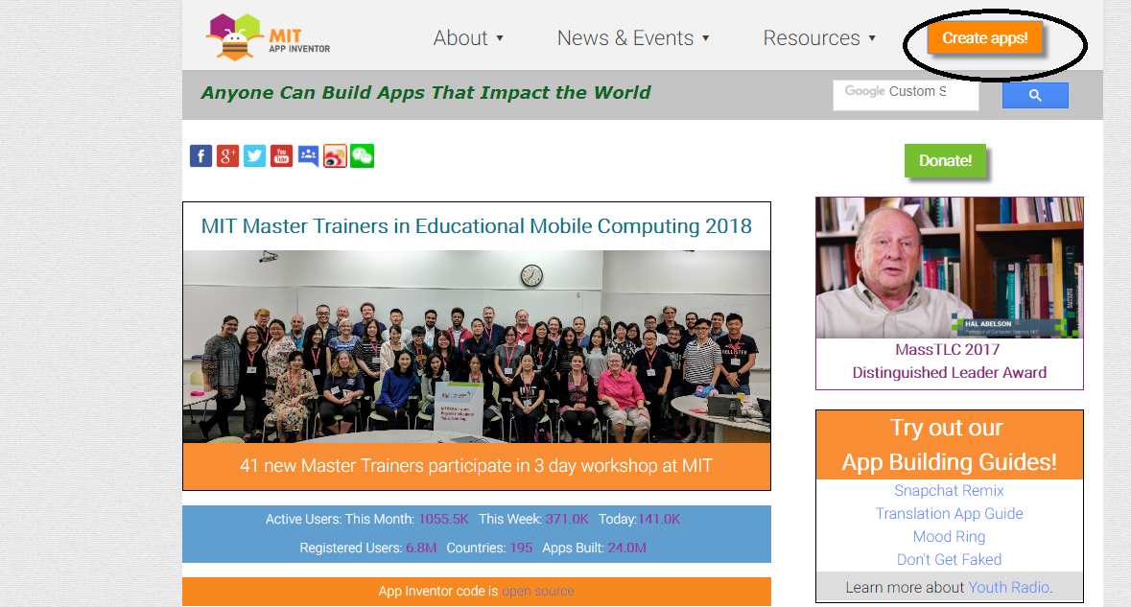
Steps to follow

Slide 9
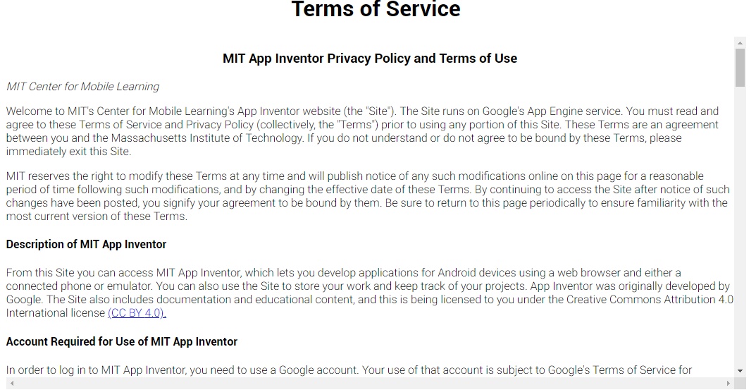

Slide 10
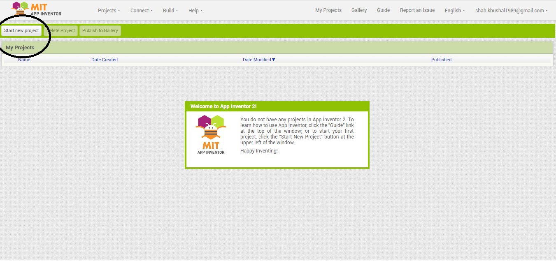

Slide 11
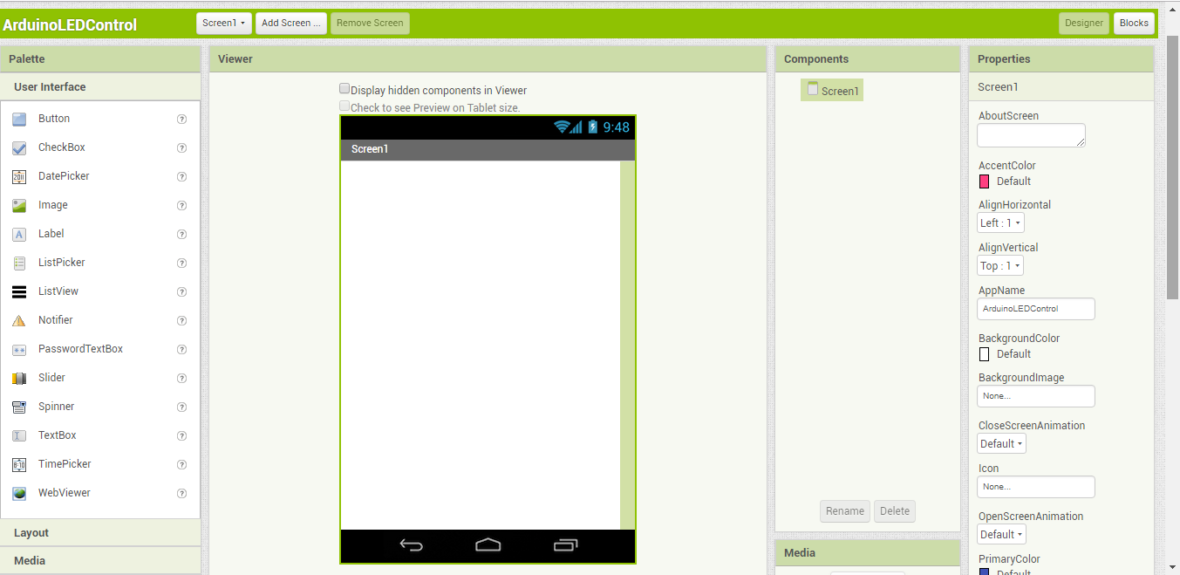

Slide 12
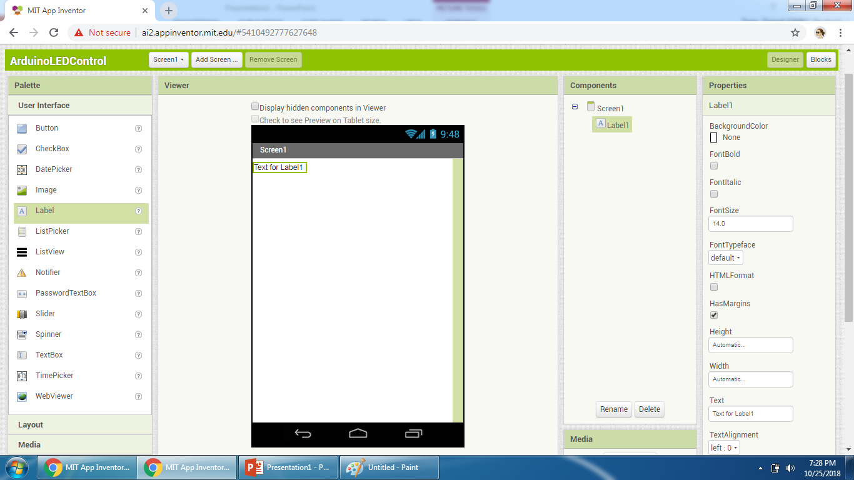

Slide 13
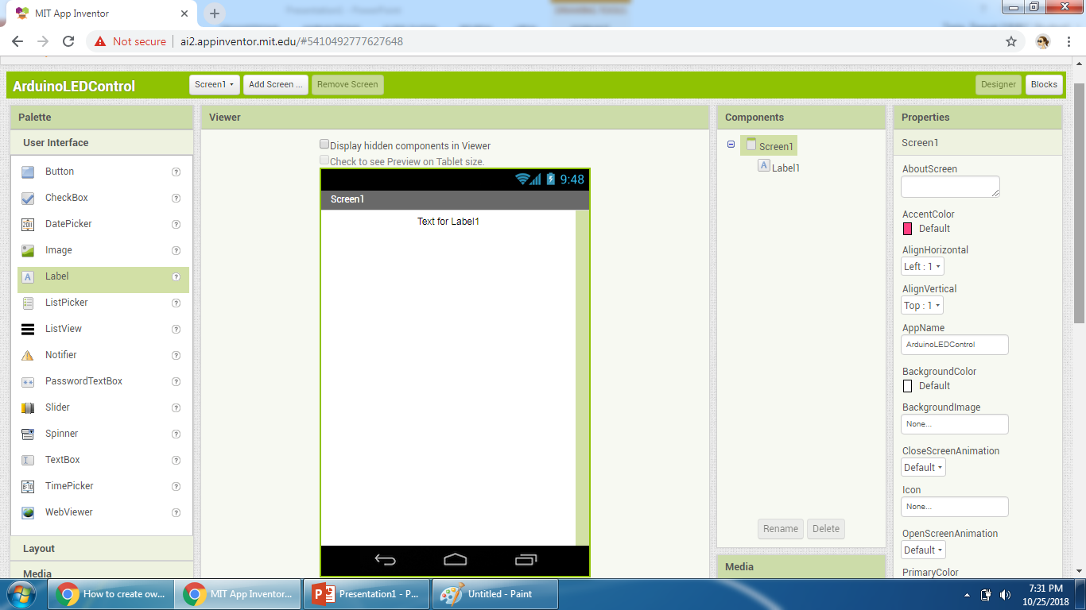
Will be filled by text later as “Connected or Not Connected”

Slide 14
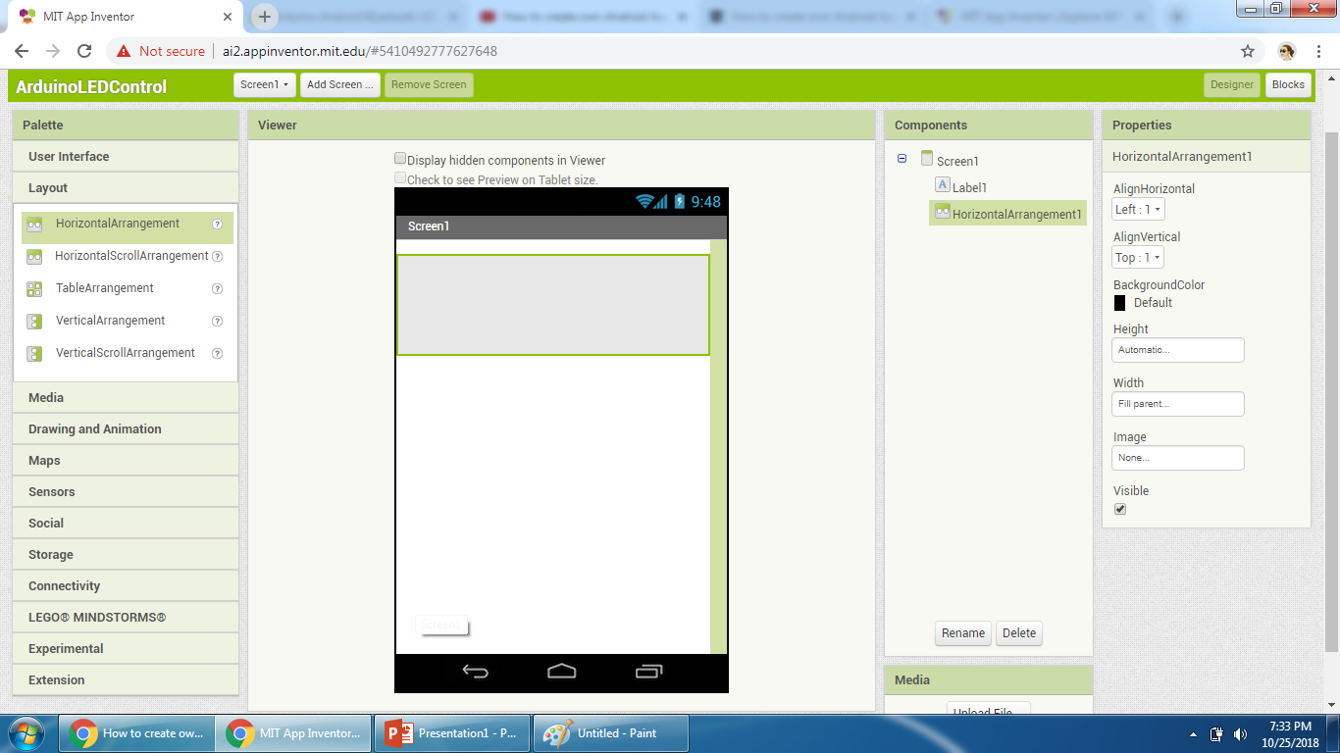
Select “Horizontal Arrangement” from Layout

Slide 15
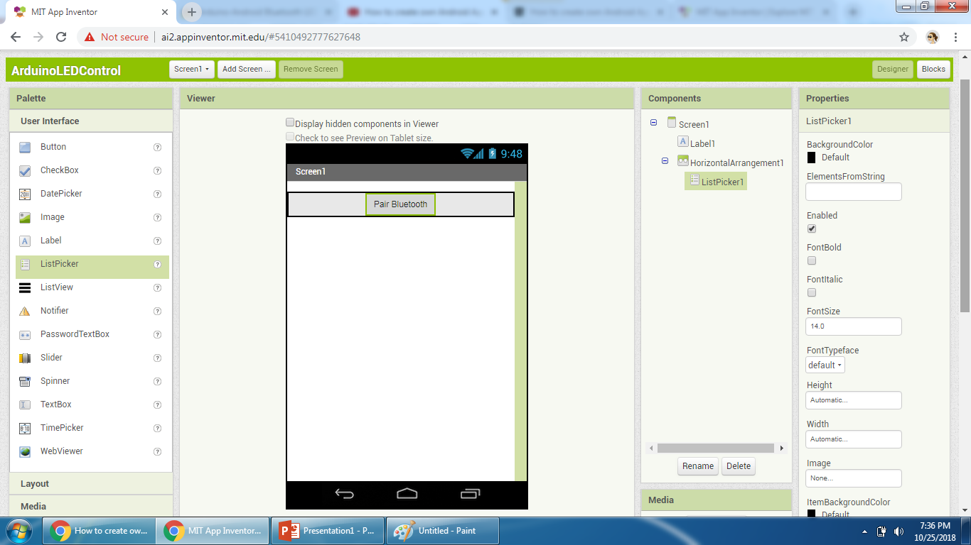
Now select “List Picker” from user interface for adding bluetooth

Slide 16
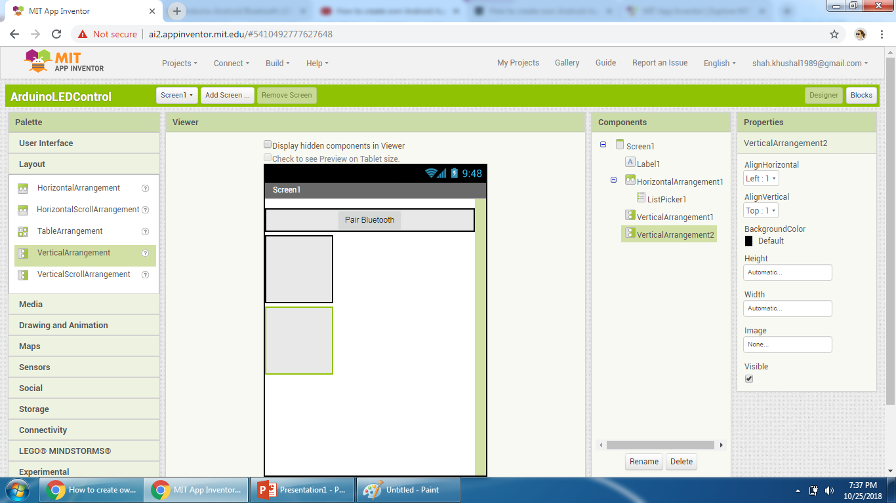
Adding LED ON and LED OFF buttons

Slide 17
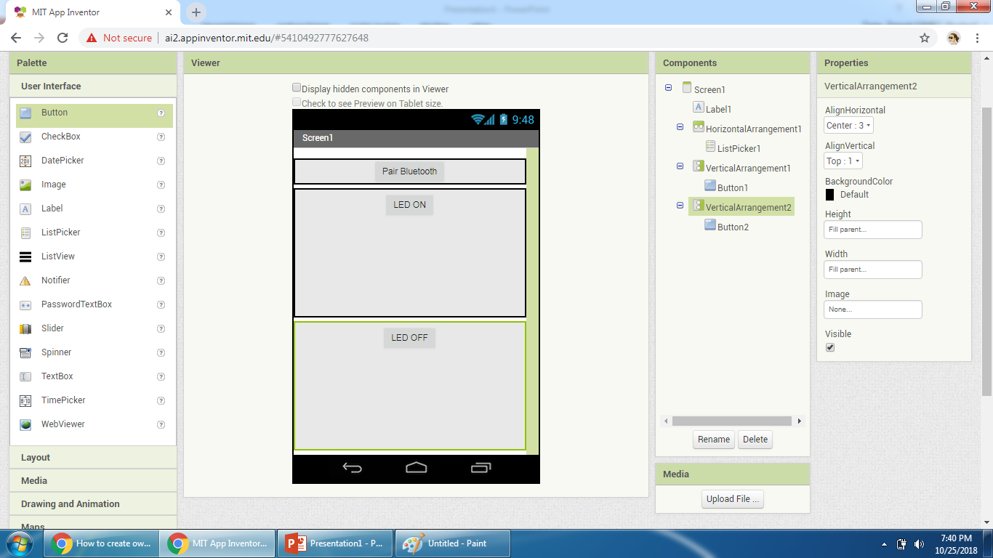

Slide 18
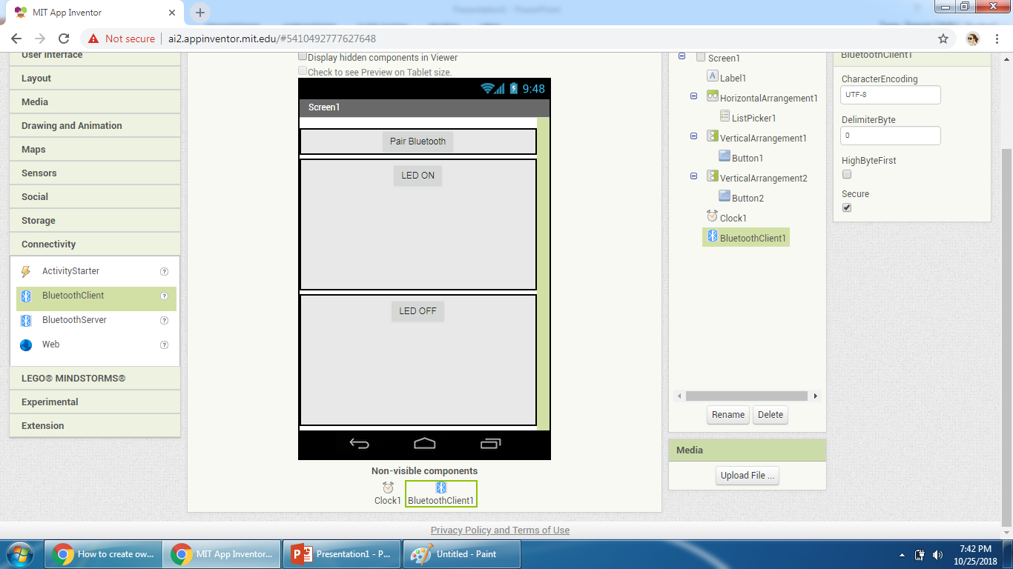
Add clock and Bluetooth client. They are invisible components

Slide 19
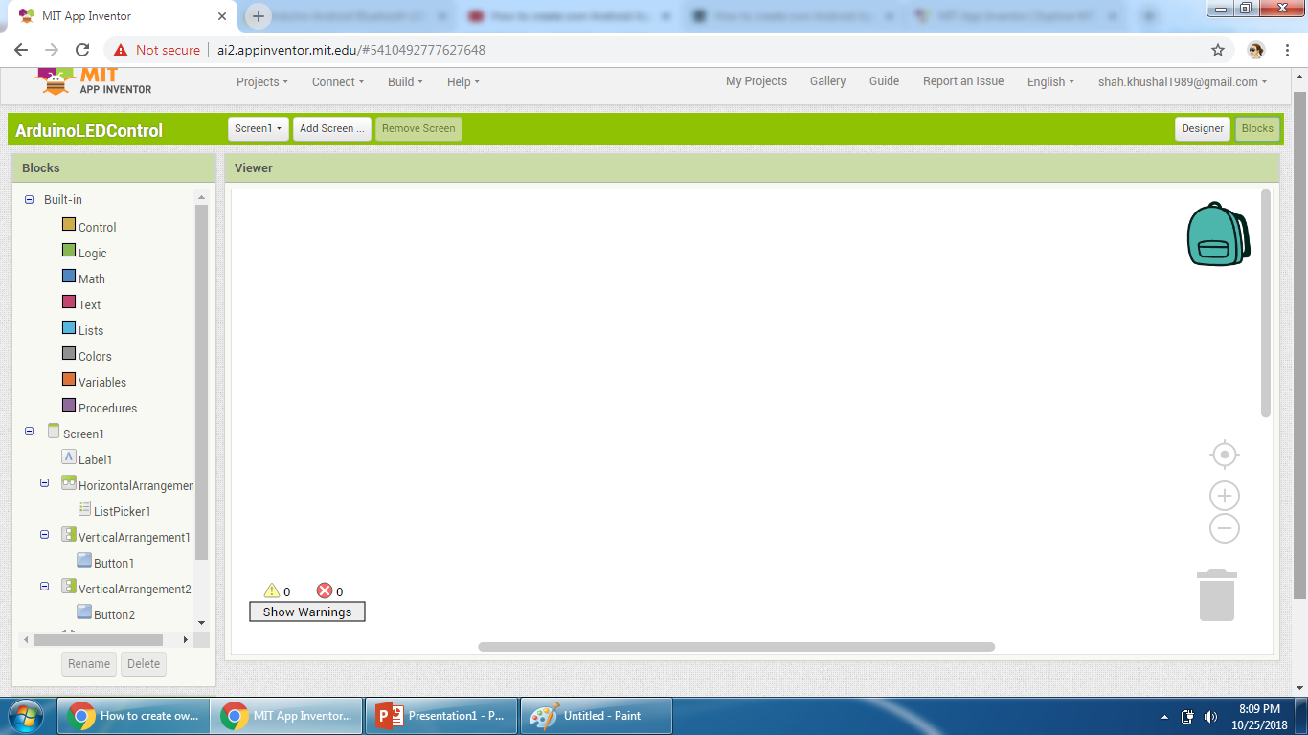
Block Editor

Slide 20
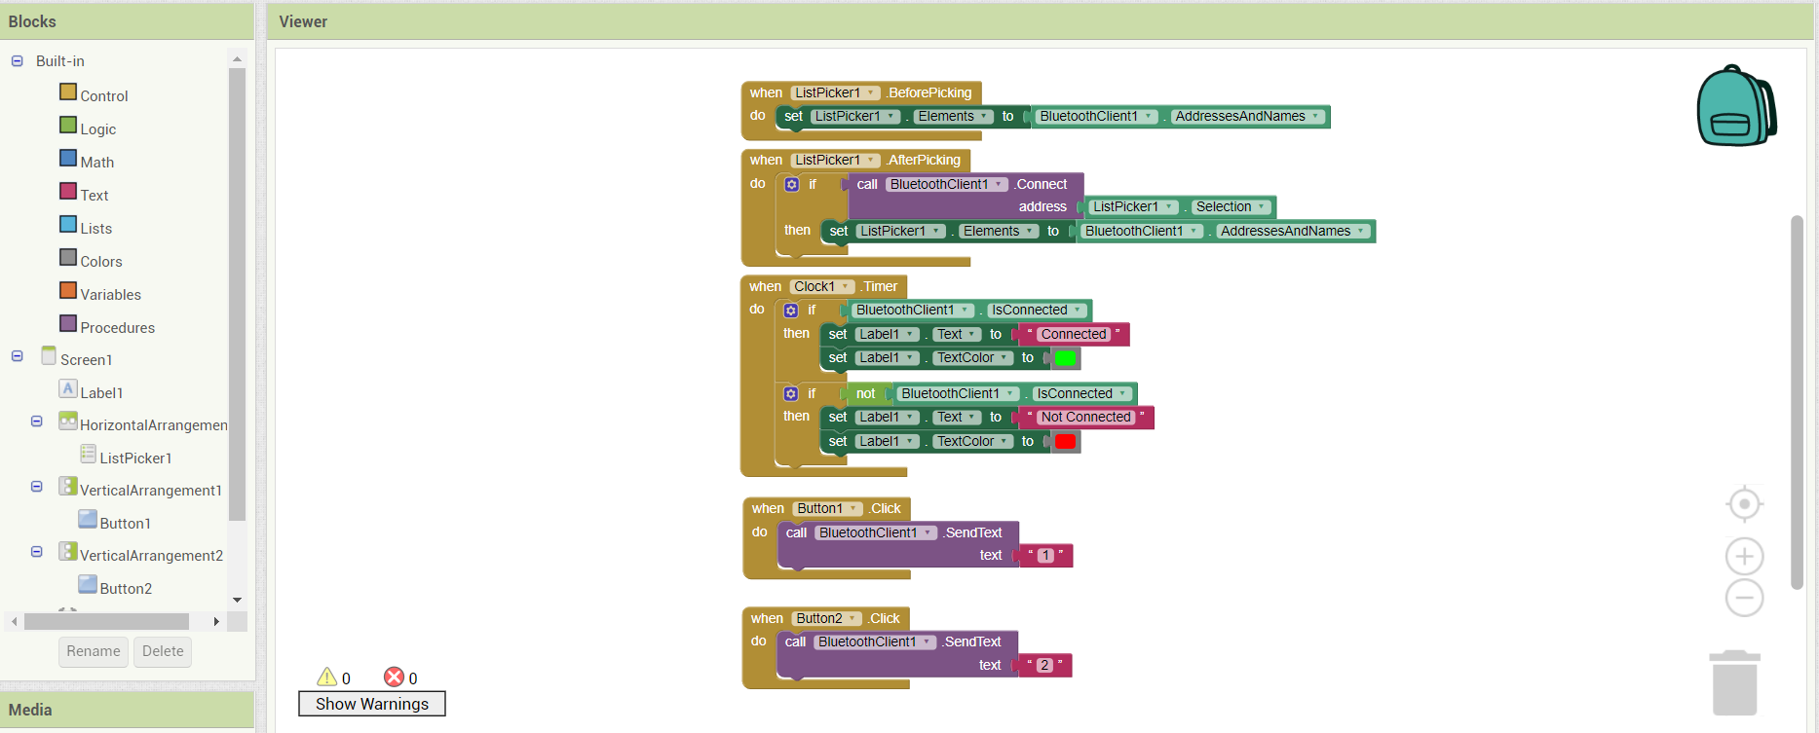

Slide 21
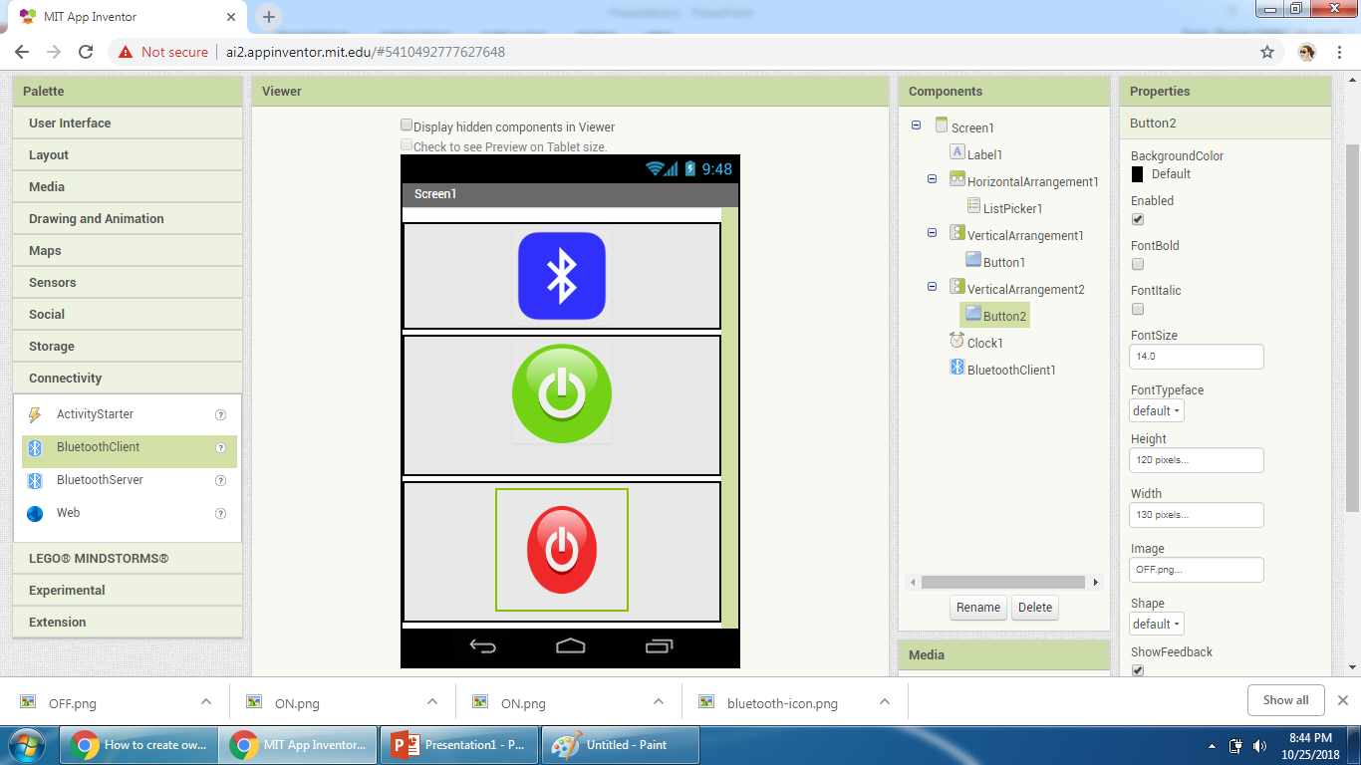
Give Graphics to Screen

Slide 22
Download MIT AI2 Companion App
Go to Google Play and Download MIT Companion App
On you app development website go to build and generate QR code
Scan QR code in your device’s MIT AI2 Companion app
It will download and install your app on your device
Note: Your computer and mobile device should be connected to same WIFI network.

Slide 23
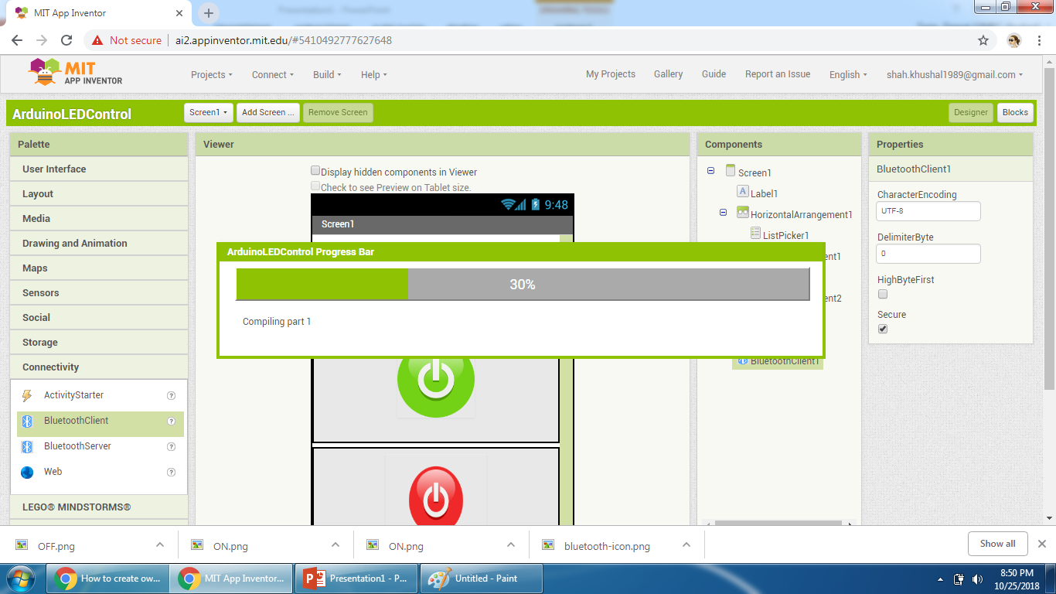
Building your App

